Slide 1

Open a Restaurant In London
A Machine Learning approached report

Slide 2
Business Problem
London is a huge city, not everyone knows London well before they go there. It is risky to move to a place you barely known.
This report addressed this problem and provide an investment guide to people who want to open a restaurant in London.

Slide 3
Data acuisition
207876
List of boroughs can be obtained from Wikipedia. https://en.wikipedia.org/wiki/List_of_London_boroughs
By using foursquare API, list of recommended venues can be fetched base on above coordinates. https://api.foursquare.com/v2/venues/explore
House sale price data on Land registry of UK, I will use data from last two years https://use-land-property-data.landregistry.gov.uk/
In total 201876 sales record are analyzed
3137 records of venues information are used to categories London boroughs

Slide 4
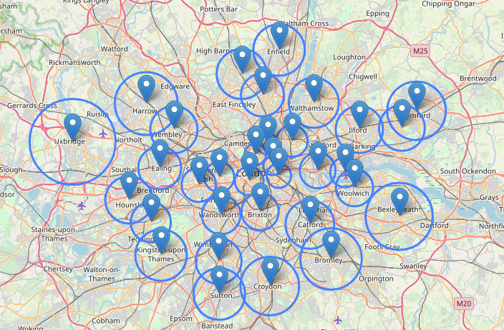
Foursquare API
Optimized radius try to get accuracy data from foursquare API to better represent a borough
Use the average distance of closest 3 boroughs

Slide 5
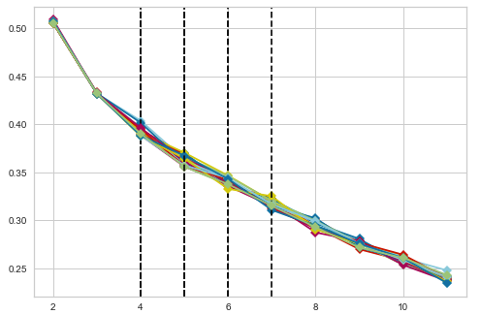
K-Mean Elbow Method
20 iterations return 17 valid results
[6, 4, 5, 5, 4, 5, 6, 5, 4, 4, 4, 4, 5, 5, 5, 7, 5]
Choose 5 as average value

Slide 6
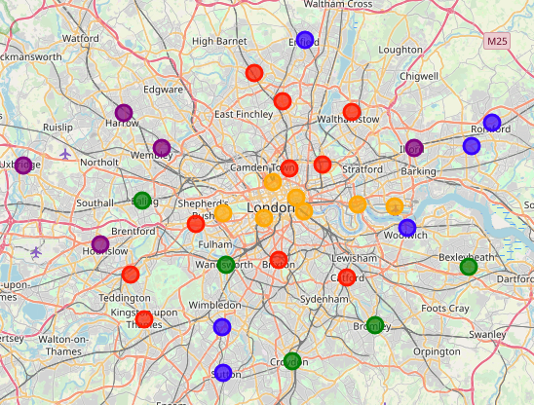
Use Unsupervised Clustering by K-Mean

Slide 7
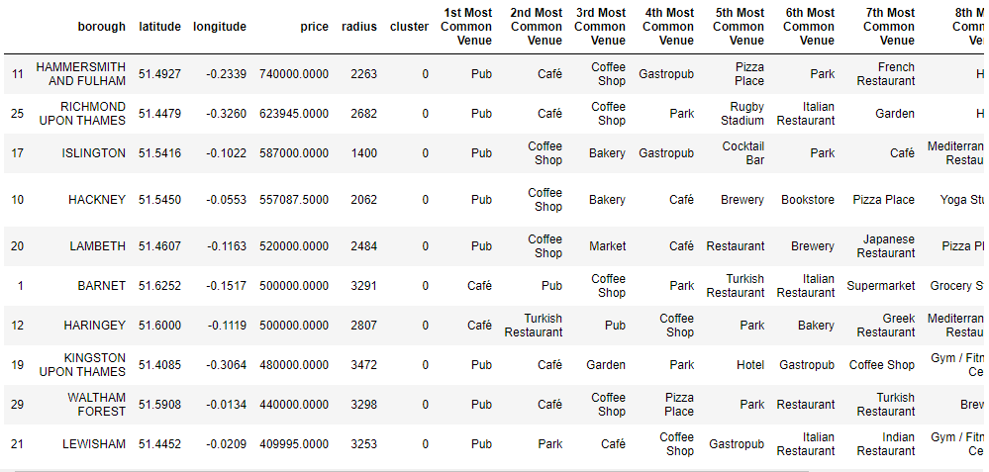
Cluster 0
Those areas have good night lives because of those pubs, Cafe, and coffee shops.
If you want to open a restaurant, go to HAMMERSMITH AND FULHAM, and try to avoid pizza, French restaurant, Japanese restaurant and Turkish restaurant.

Slide 8
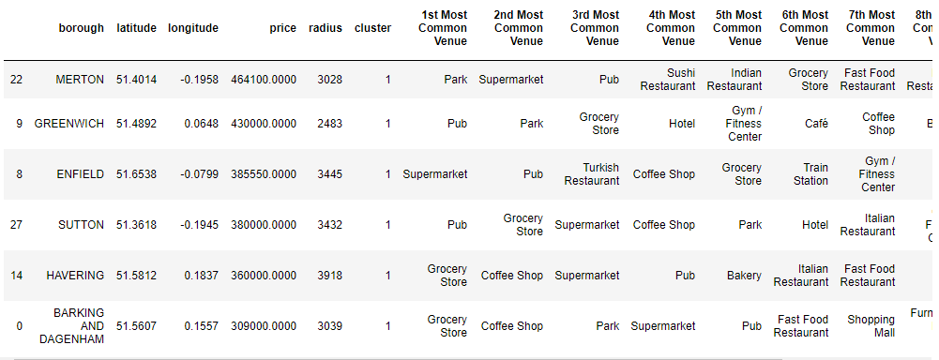
Cluster 1
Areas for livings. Because of the supermarkets and grocery stores there. With convenient transportations the difference in average house price are not so big.
If you want to open a restaurant, try to go to MERTON, and try to avoid Sushi, Indian, and Italian restaurants.

Slide 9
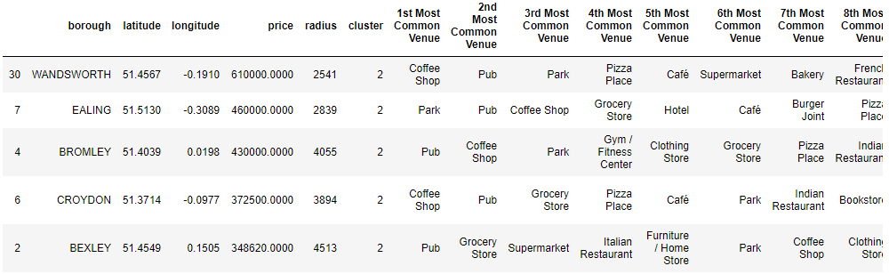
Cluster 2
Places mixed with nature and inhabitants.
Open a restaurant in WANDSWORTH, and avoid pizza, burger, French and Thai restaurant.

Slide 10
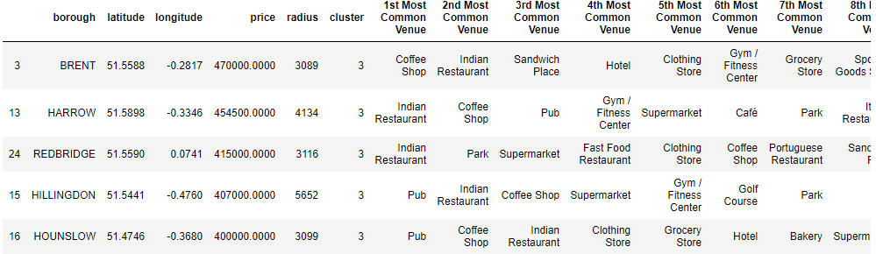
Cluster 3
Those areas have lots of Indian restaurant. The house price is quite average here.
Go to BRENT for slightly higher price. Avoid open another Indian restaurant in those areas.

Slide 11
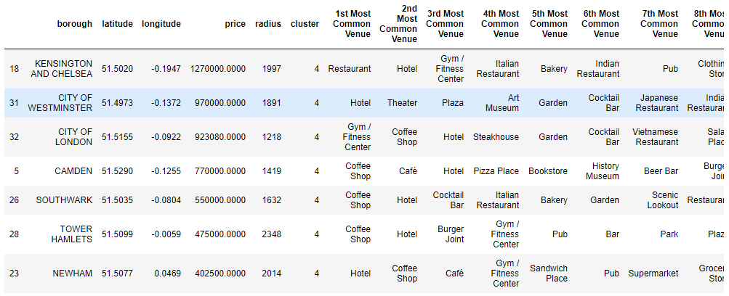
Cluster 4
Areas with highest house price, have lots of hotels and coffee shop, good places for tourism and business.
Go to KENSINGTON AND CHELSEA if possible and avoid opening Italian and Indian restaurant.

Slide 12
Conclusion
Built a generic categorization model for cities, To help user to get familiar with this city.
Accuracy of the model can be improved by
Get more precise data to indicate the purchase power of boroughs
Get more precise data to describe the borough better
Obtain data by more accurate geo shape
Obtain more venues to be used in categorization process

